Slide 1


Balanced Nutrition

Slide 2
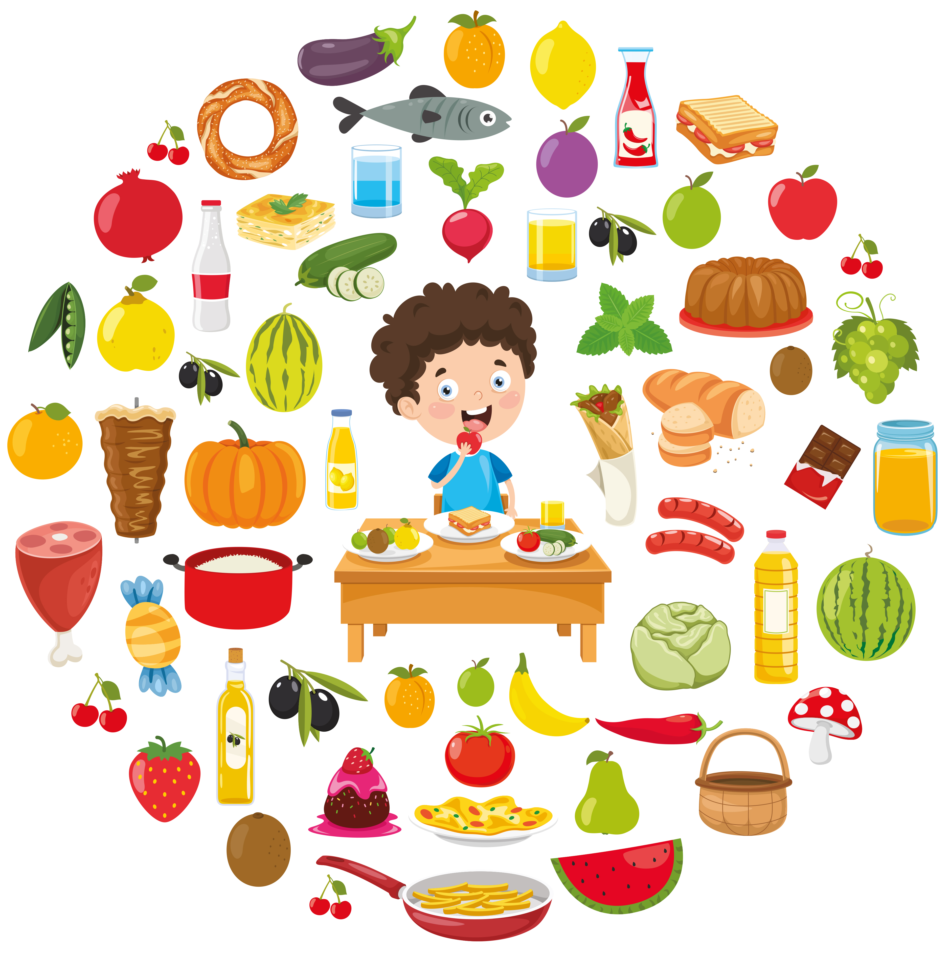
FOOD

Slide 3
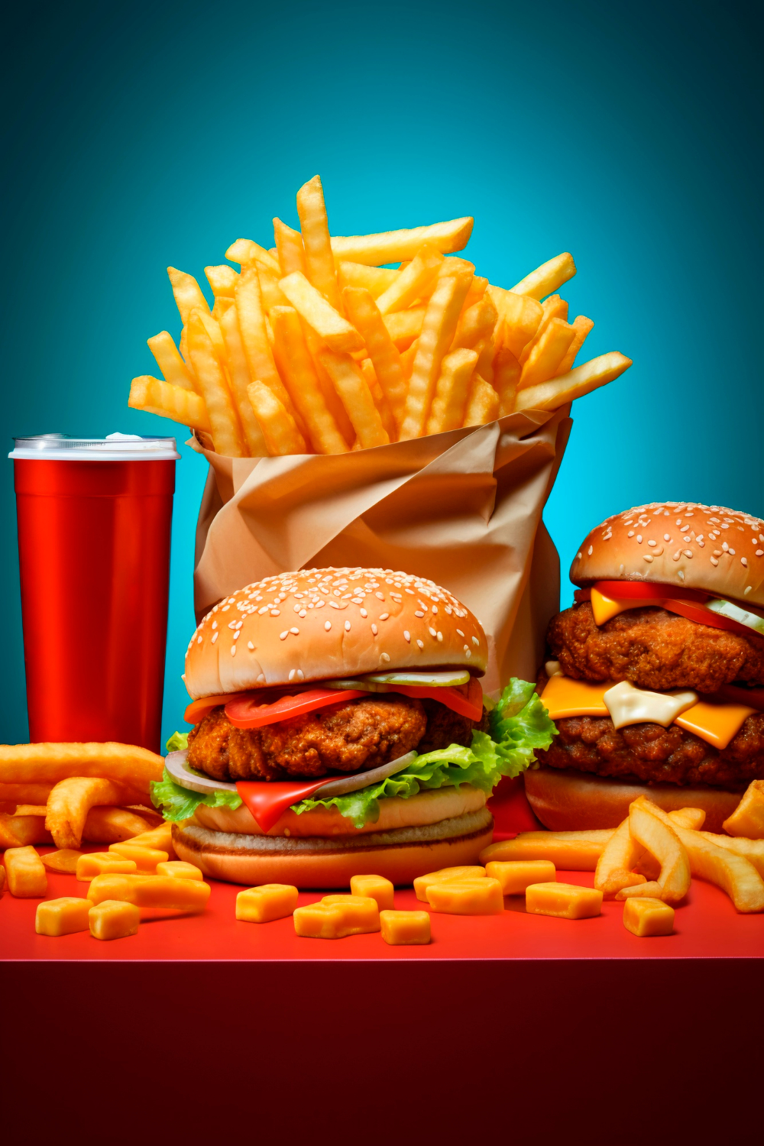
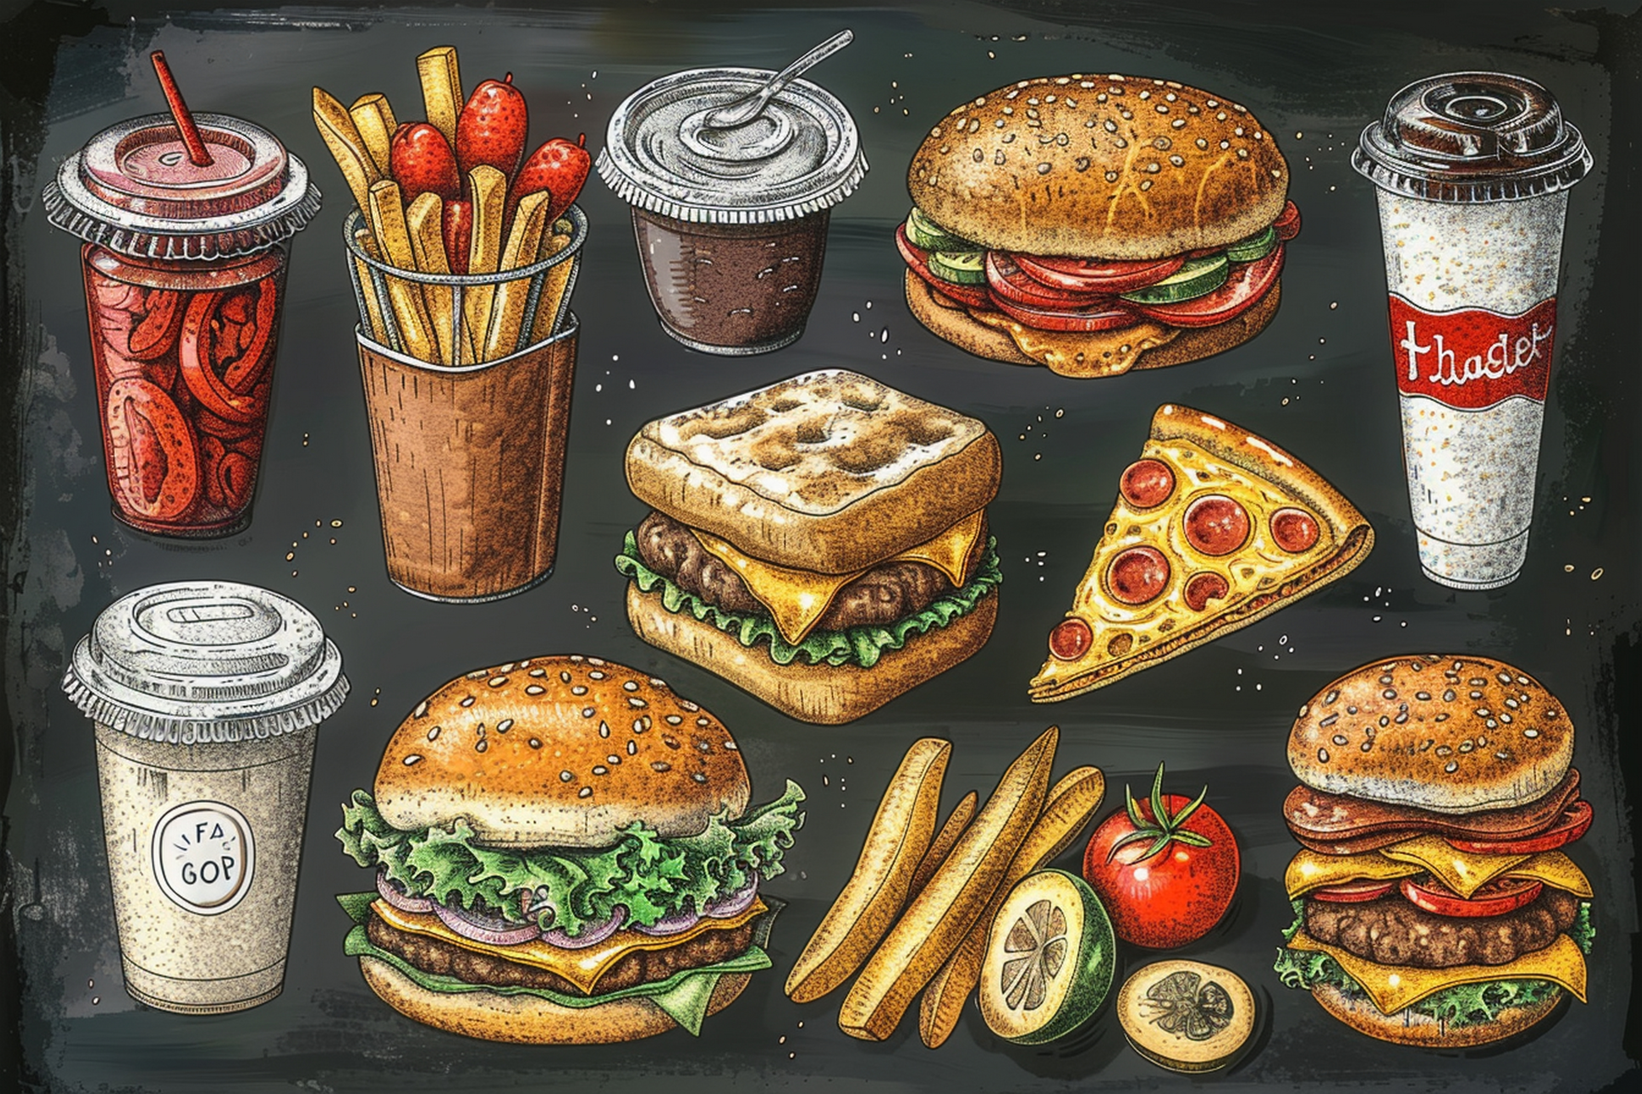
FAST FOOD

Slide 4
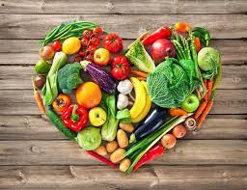
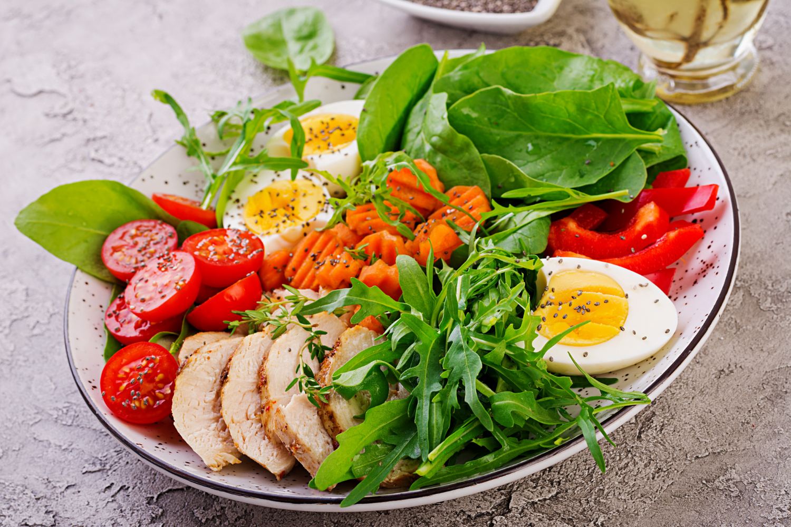
HEALTHY

Slide 5
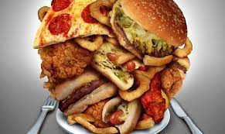
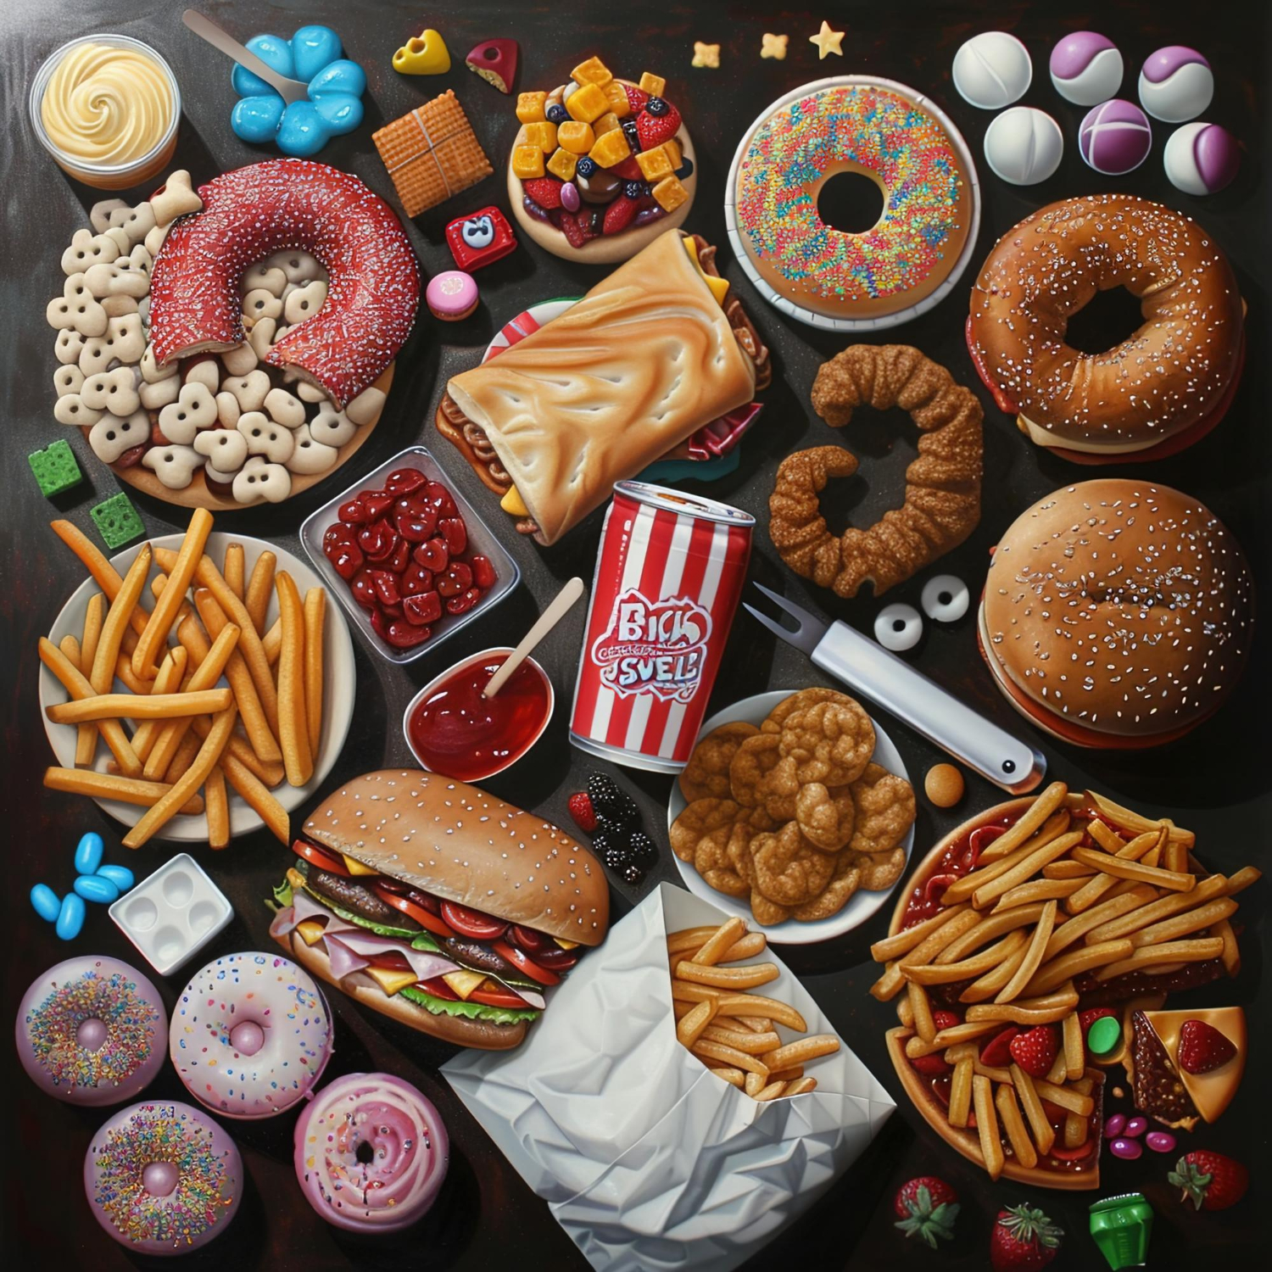
UNHEALTHY

Slide 6
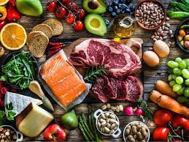
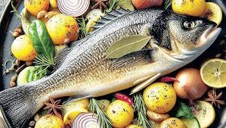
NUTRITIOUS

Slide 7
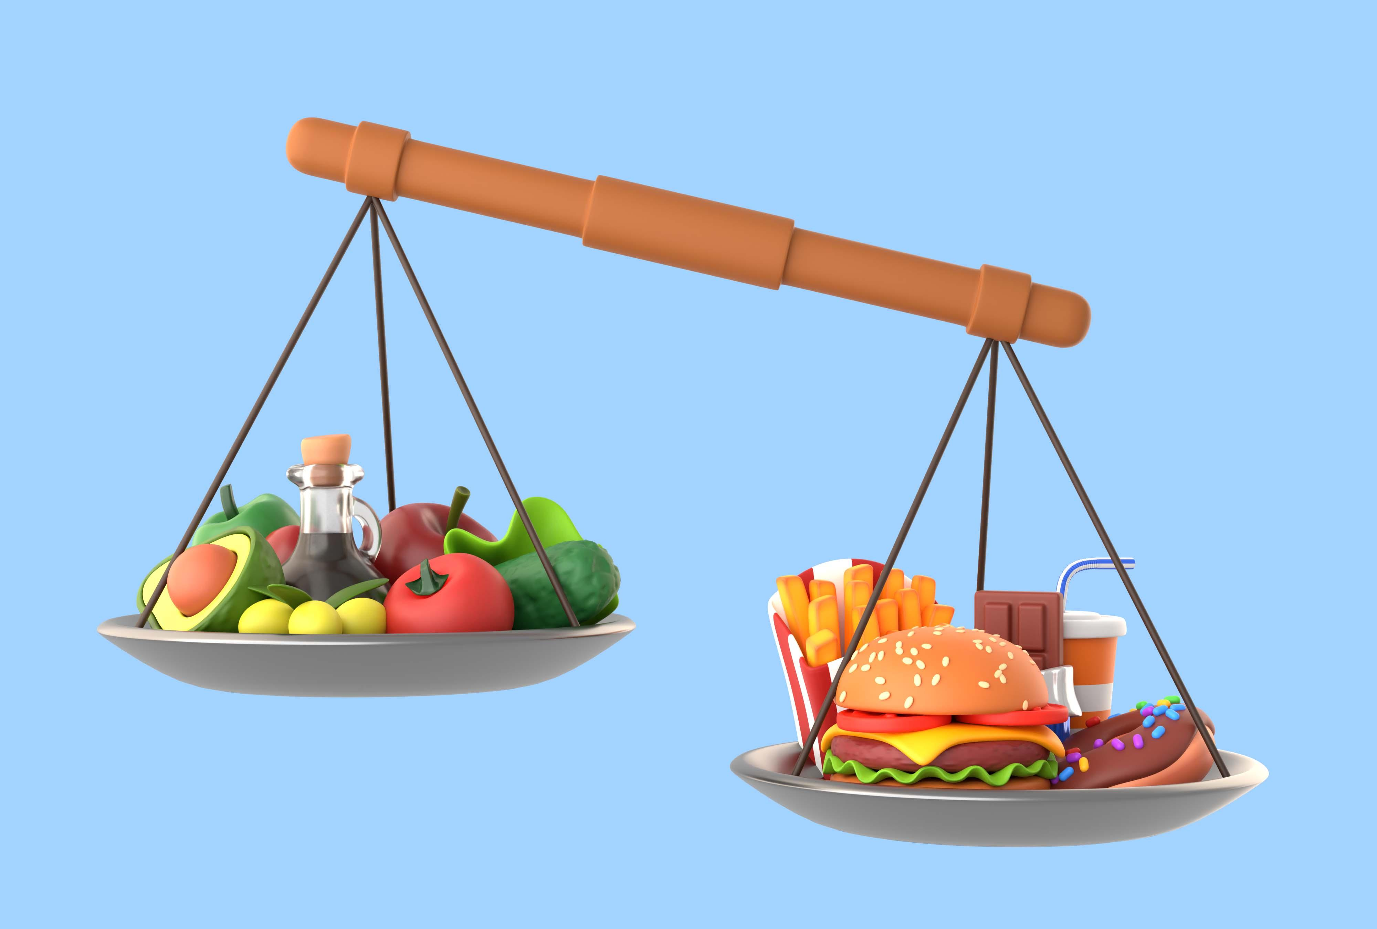
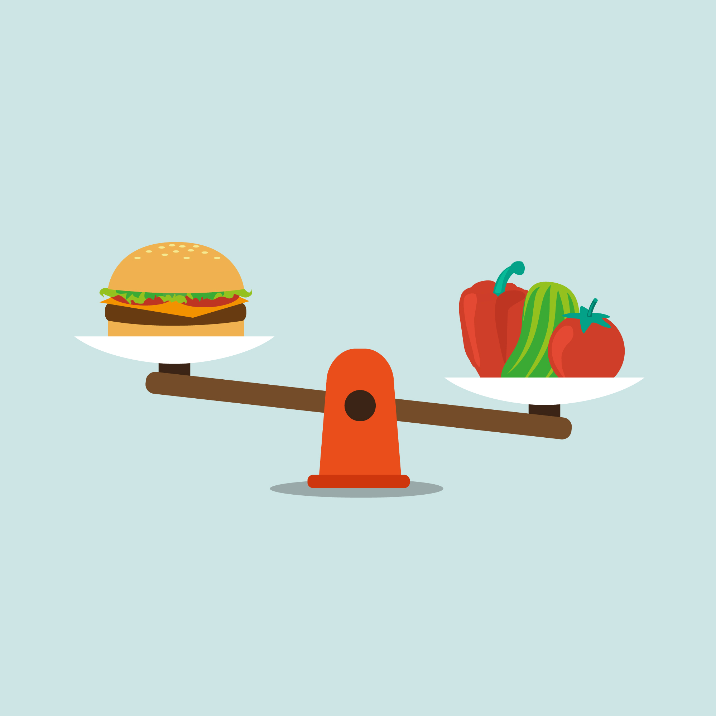
BALANCED NUTRITION

Slide 8





2022-1-BG01-KA220-SCH-000085065
School subject: Natural Science
Students’Age: 8 years
Topic: Balanced Nutrition
Credits: Antalya Directorate Of Education
All media are within the EU intellectual property law.
The European Commission’s support for this publication does not constitute an endorsement of the contents, which reflect the views only of the authors, and the Commission cannot be held responsible for any use which may be made of the information contained herein.

